Slide 1
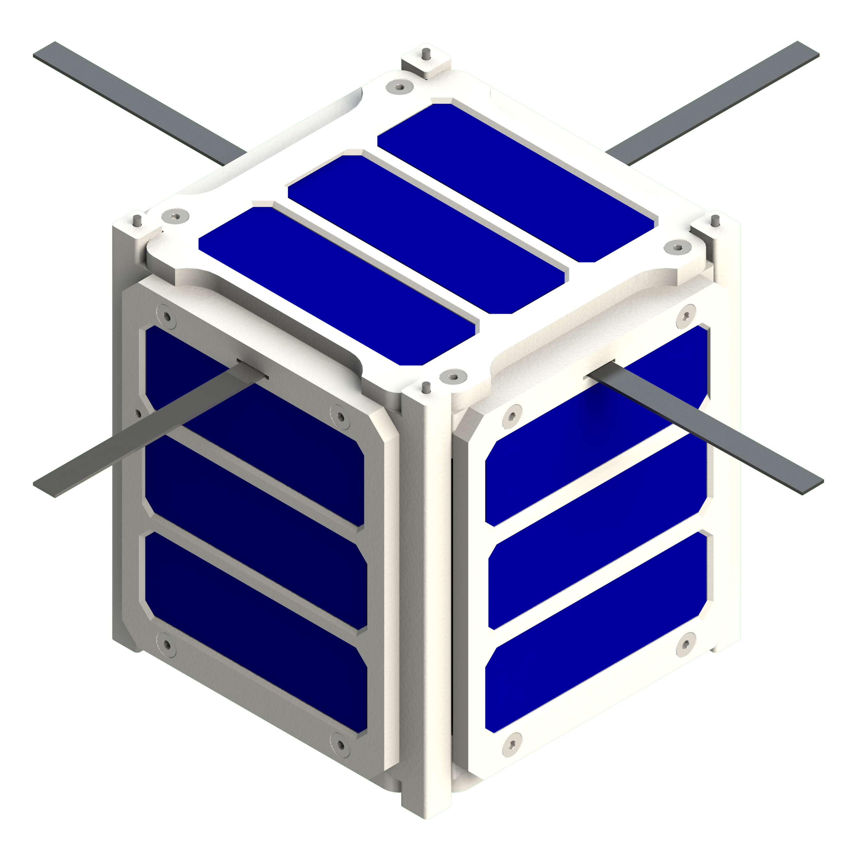
Undergraduate Design of a Proprietary, Low-Cost "QUbeSat"
Marcus Rocco Fratarcangeli, Anthony DiMauro, Gary DeVilbiss, & Napoleon Stardellis
Notes:
Hi everyone, my name is Rocco, we are senior mechanical engineering student graduating in the spring of 2023, and this is our senior design project

Slide 2
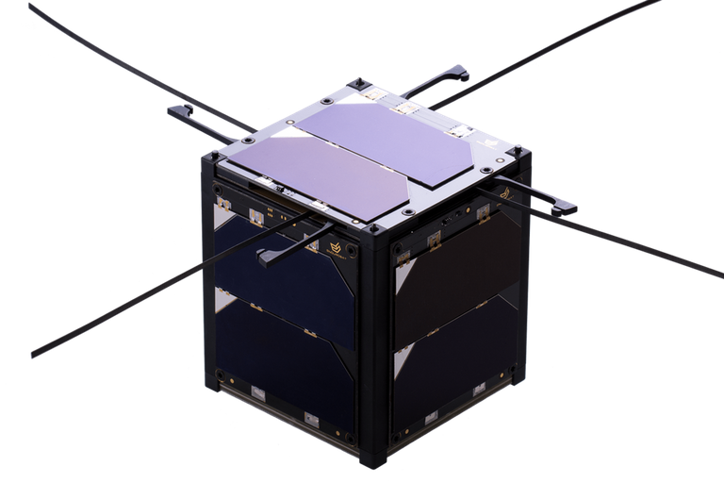
What is a CubeSat?
Introduction
Class: nanosatellites
Standardized form factor
Ideal academic projects
Application of many engineering disciplines
Notes:
To start, I just want to apologize in advance for my voice, I am recovering from some allergies affecting my throat. Back to it, Our project was creating a prototype CubeSat for a technology demonstration and proof of concept. CubeSats are small satellites belonging to a class called nanosatellites, which are determined by their standardized form factor and low weight. One CubeSat ‘unit’ is approximately 10x10x10 cm and weighs less than 2kg, which you can see an example of on the right image. Because of their small size and relatively low cost, CubeSats are ideal academic projects. They require the application and integration of knowledge and skills across many engineering disciplines.

Slide 3

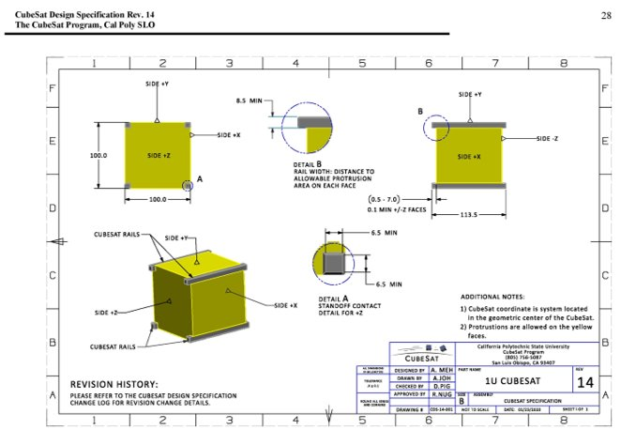
Problem Statement
Motivation
Test an additively manufactured frame material
Collect on-orbit temperature data to transmit to ground station
Meet launch requirements by NASA and Cal Poly
No more than $2000 and complete by May 2023
Notes:
Our problem statement was to design a CubeSat that will test an additively manufactured frame material, collect on-orbit frame temperature data, and transmit that data to a ground station. We determined the CubeSat should be high-quality, durable, meet the requirements for launch laid out in the Cal Poly and NASA handbooks, and must not exceed $2000 for the final launch hardware. The project should be completed by the end of the spring semester (May 2023). Additionally, Quinnipiac University has never built a CubeSat, so this was our first foray into space engineering.

Slide 4
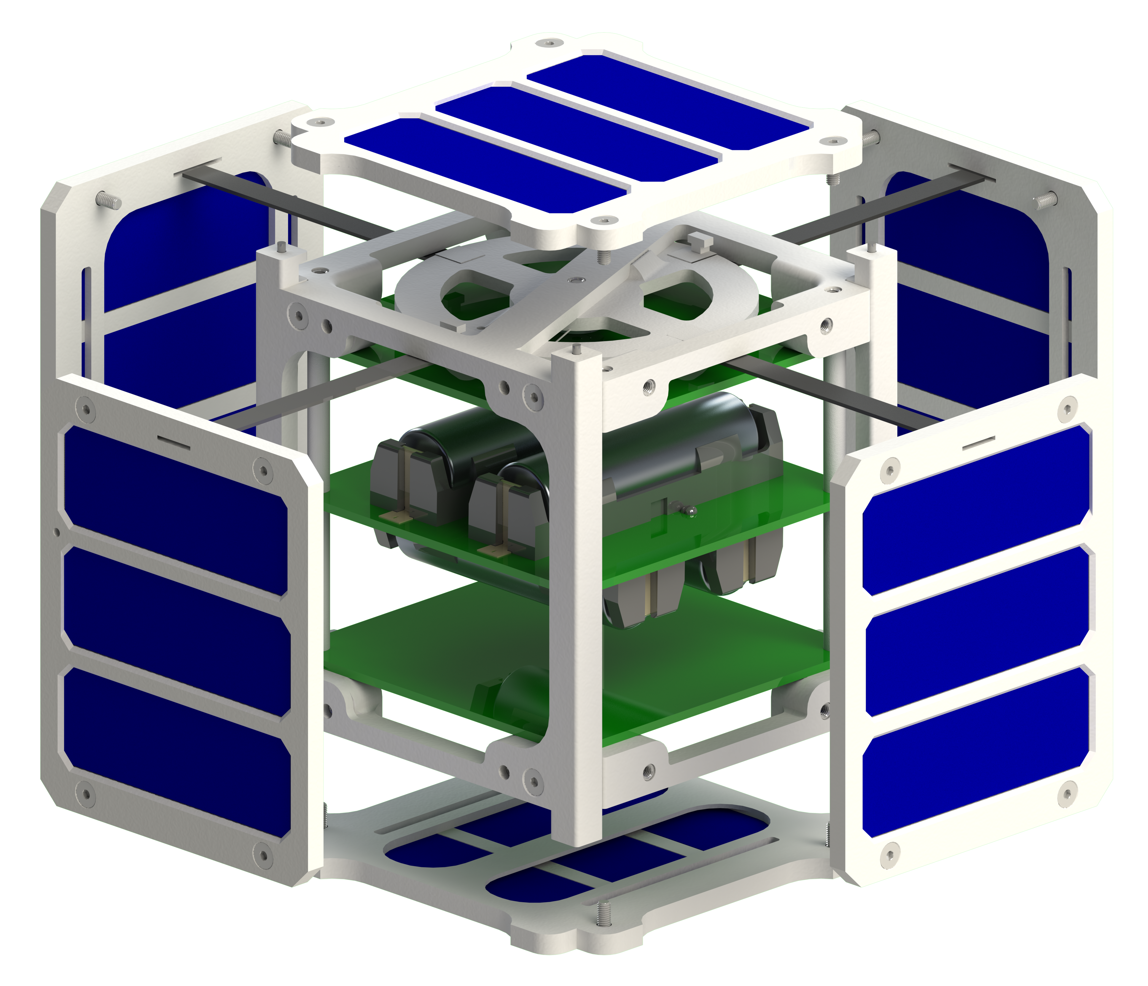
Frame Design
Final design & systems
g
ULTEM 9085 thermoplastic resin
Houses the main systems on PCBs
Proprietary frame, solar panels, and antenna deployment
e
b
c
f
a
M3x0.5 Heat Set Insert​
M3x0.5 Steel Screw​
Pillar Wall
Bottom Support
Antenna System
XY Solar Panel
Z Solar Panel
b
d
c
d
e
f
g
a
QUbeSat exploded view
Notes:
Regarding the frame design, the proprietary ULTEM 9085 resin thermoplastic frame houses the main systems on their respective printed circuit boards. The focus of the design was 3D printing components to replace OTS parts, making them less expensive and more lightweight. For example, the frame design, antenna system, and solar panels, will be made from the thermoplastic and will allow us to keep the budget of the CubeSat hardware under $2000, as you can see from the prototype and the exploded view.

Slide 5
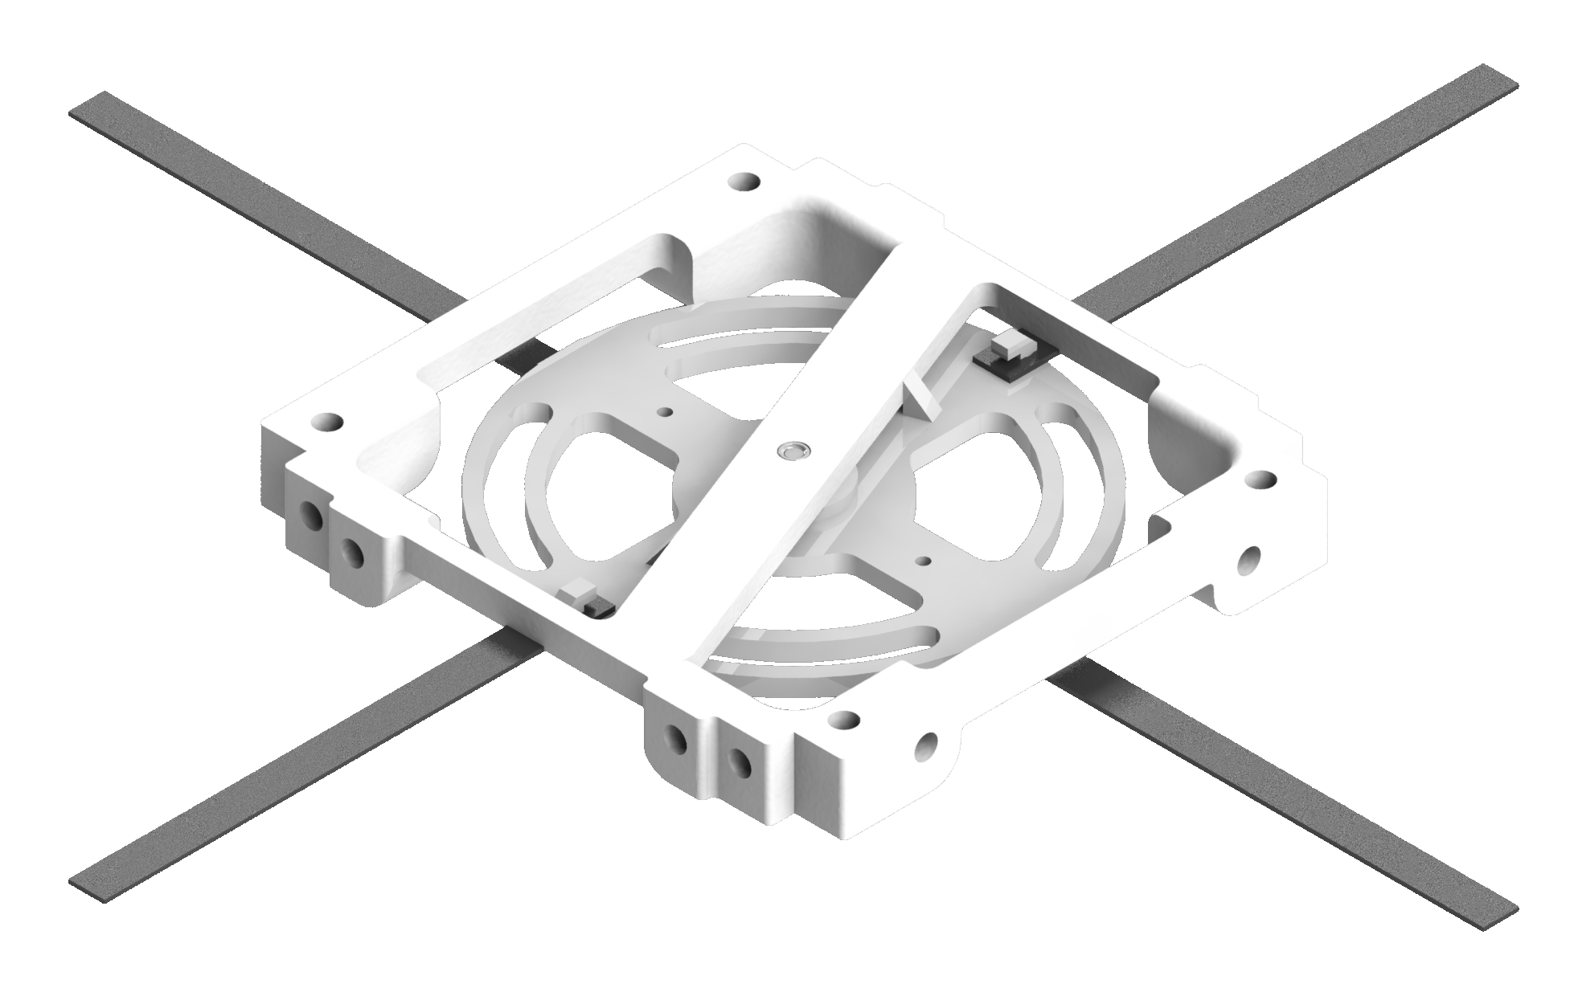
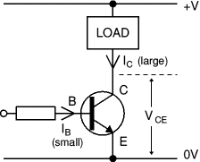
Antenna Deployment System
Final design & systems
Antennas are hidden until deployment
Transistor receives signal to send current for deployment
Spring mechanism releases antennas
Notes:
The antennas are secured to the rotating disk within the CubeSat frame until deployment. Which is achieved through a preloaded torsion spring, held in the preloaded position by a nylon wire running through the disk. When we are ready to deploy there will be a signal to a transistor (circuit seen in slide) which will send current to a burning resistor which will burn the tense nylon wire releasing the tension that holds the disk in place and the spring will rotate to force the antennas through the slot to the exterior of the frame which the deployed antennas appear as they do in the image

Slide 6
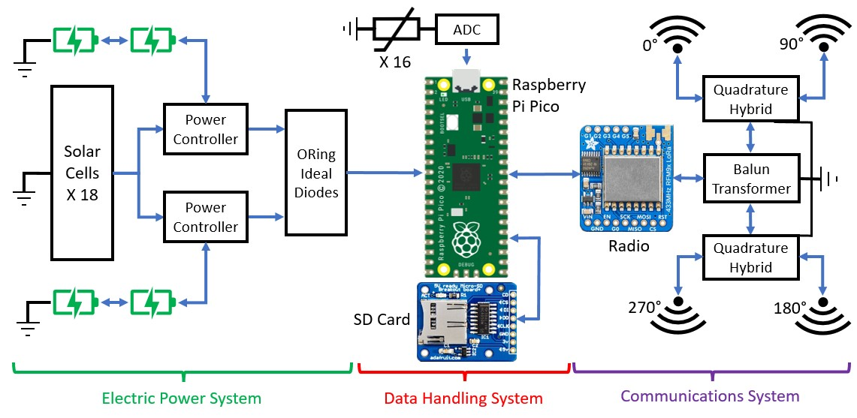
System Workflow
Final design & systems
Notes:
And now for the internal system workflow, which we will break down over the next several slides

Slide 7
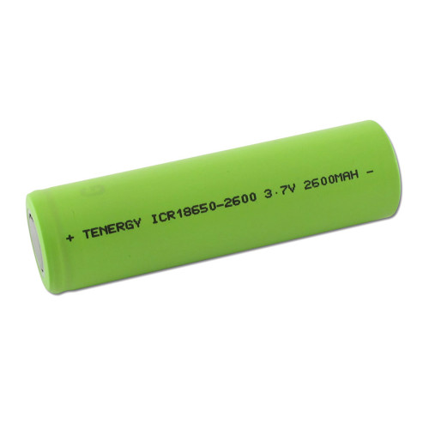
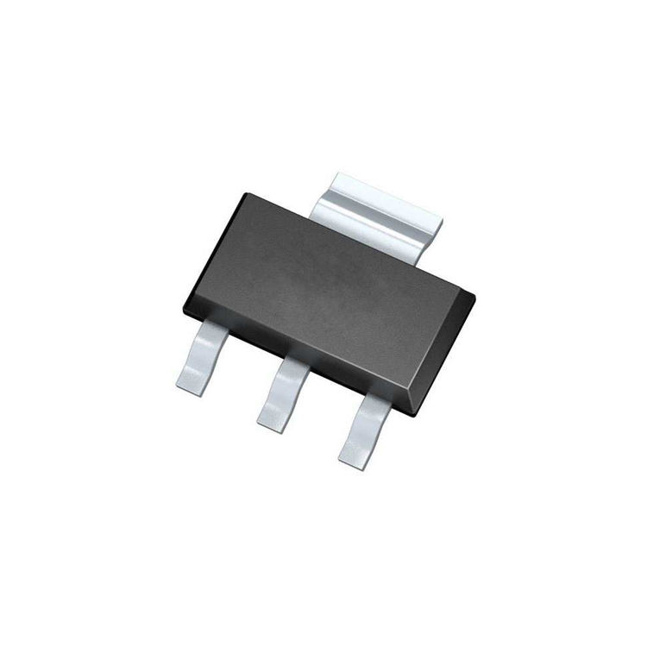
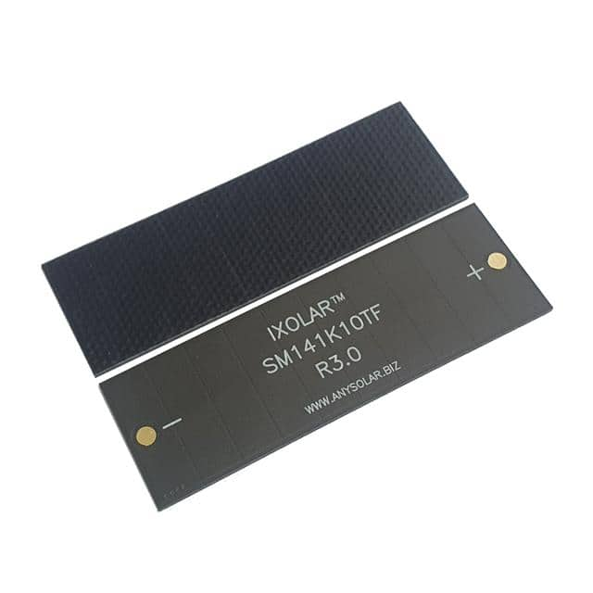
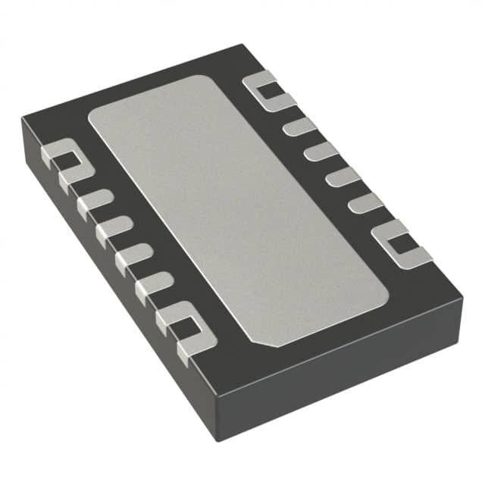
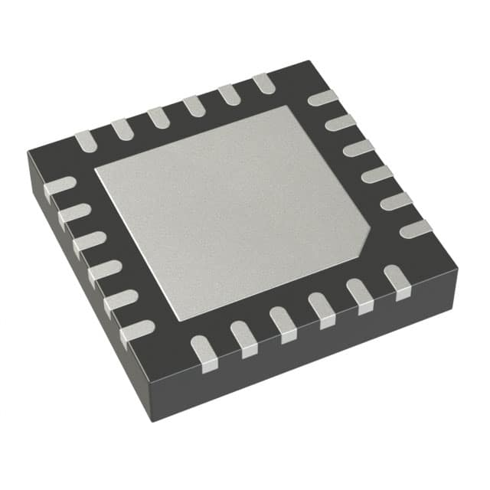
Electrical Power System
Final design & systems
6 Solar Panel Assemblies
Charge batteries and power data handling system
Redundancy and voltage regulation
Notes:
Our electric power system consists of solar panels, rechargeable batteries, and power controllers. Solar panels are assembled on every side of the CubeSat to power all systems and charge the li-ion batteries when sunlight is present in orbit. When sunlight is not present, the power regulating charge controllers will switch system power solely to the batteries. This cycle will repeat each orbit to keep the satellite powered during all stages of the mission

Slide 8
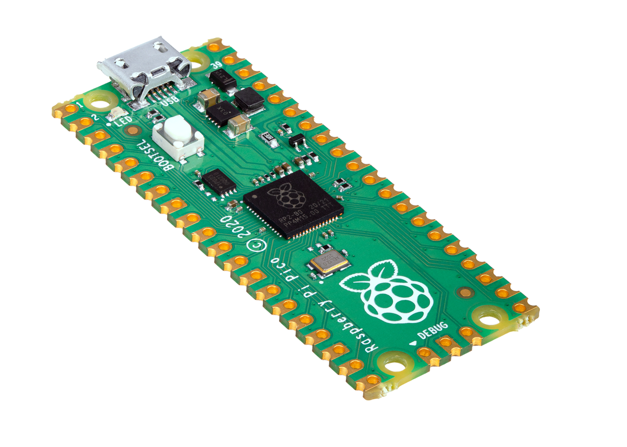
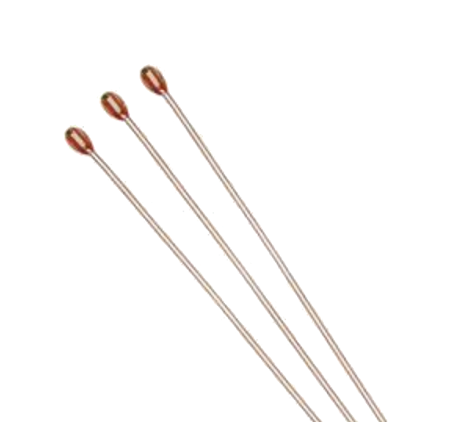
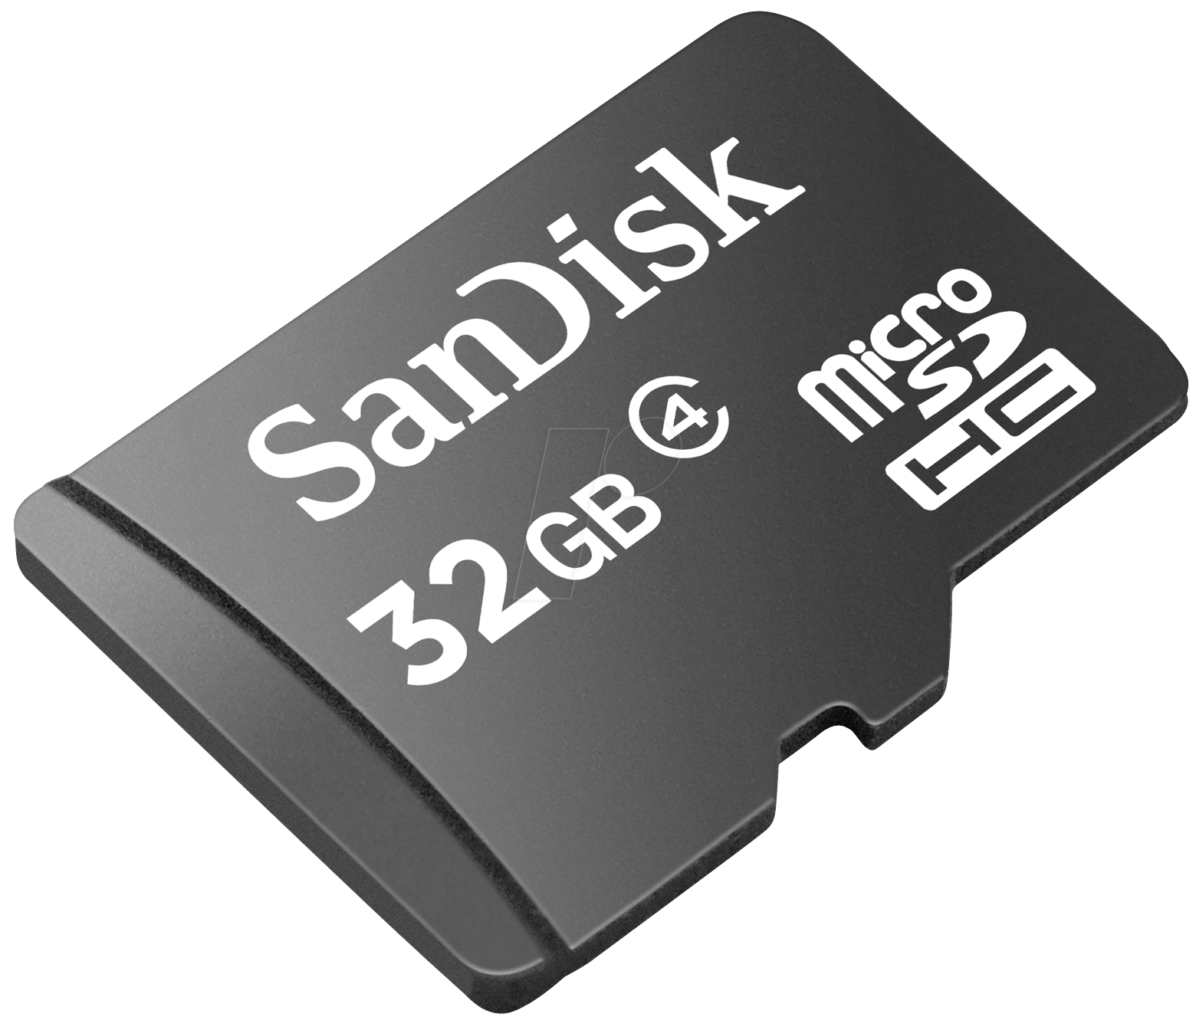
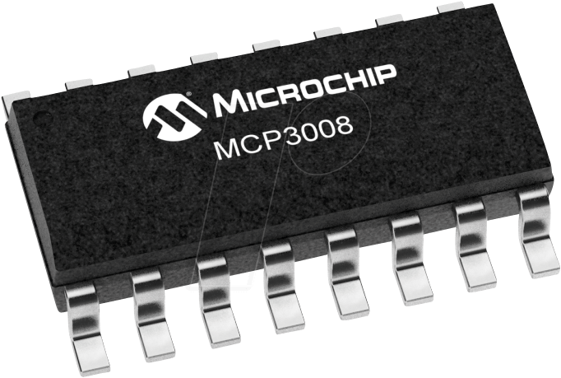
Data Handling System
Final design & systems
Raspberry Pi Pico
Thermistors to analog-to-digital converters to an SD card
Prepare the data to transmit
Notes:
Our data handling system uses a Raspberry Pi Pico to control the subsystems. For the temperature measurements, 16 thermistors are used inside of the pillars of the frame which send analog data to the ADCs and the Pico. These are then stored on an SD card and prepared to transmit.

Slide 9
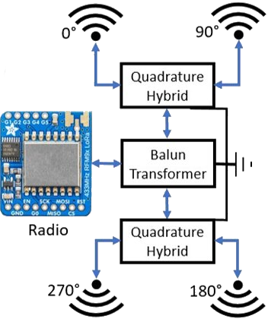
Communications System
Final design & systems
Operates in the UHF US Amateur Radio Band at 433MHz
Uses an Adafruit RFM96W LoRa Radio Transceiver Breakout Board
Radio obtains a digital signal from the Raspberry Pi and converts it into an analog signal
Future designs will use a crossed-dipole antenna to increase gain and range
433 MHz
Notes:
Our communications system uses a radio that operates at 433 MHz and a crossed-dipole antenna. It is important to note that this frequency lies within a U.S. Amateur Radio Band which required me to obtain an amateur radio license to use. To briefly explain the right side of Figure 3, the radio will receive a digital signal from the Raspberry Pi and convert it to an analog signal. This is then fed through a quadrature circuit which splits the signal into four parts with a 90° phase shift between each signal. This is done to achieve circular polarization which increases the gain and range of the radio.

Slide 10
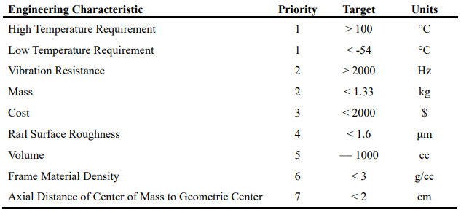
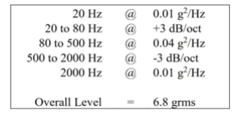
Engineering Characteristics & Target Values
Engineering specifications
Many of the engineering characteristics chosen for this project were selected based on standards outlined by the California Polytechnic Institute, testing requirements established by The Aerospace Cooperation and NASA, and specifications needed to carry out this CubeSat's mission.
Full Vibration Resistance Table
Notes:
Many of the engineering characteristics chosen for this project were selected based standards outlined by the California Polytechnic Institute, testing requirements established by The Aerospace Cooperation and NASA, and specifications needed to carry out this CubeSat's mission.

Slide 11
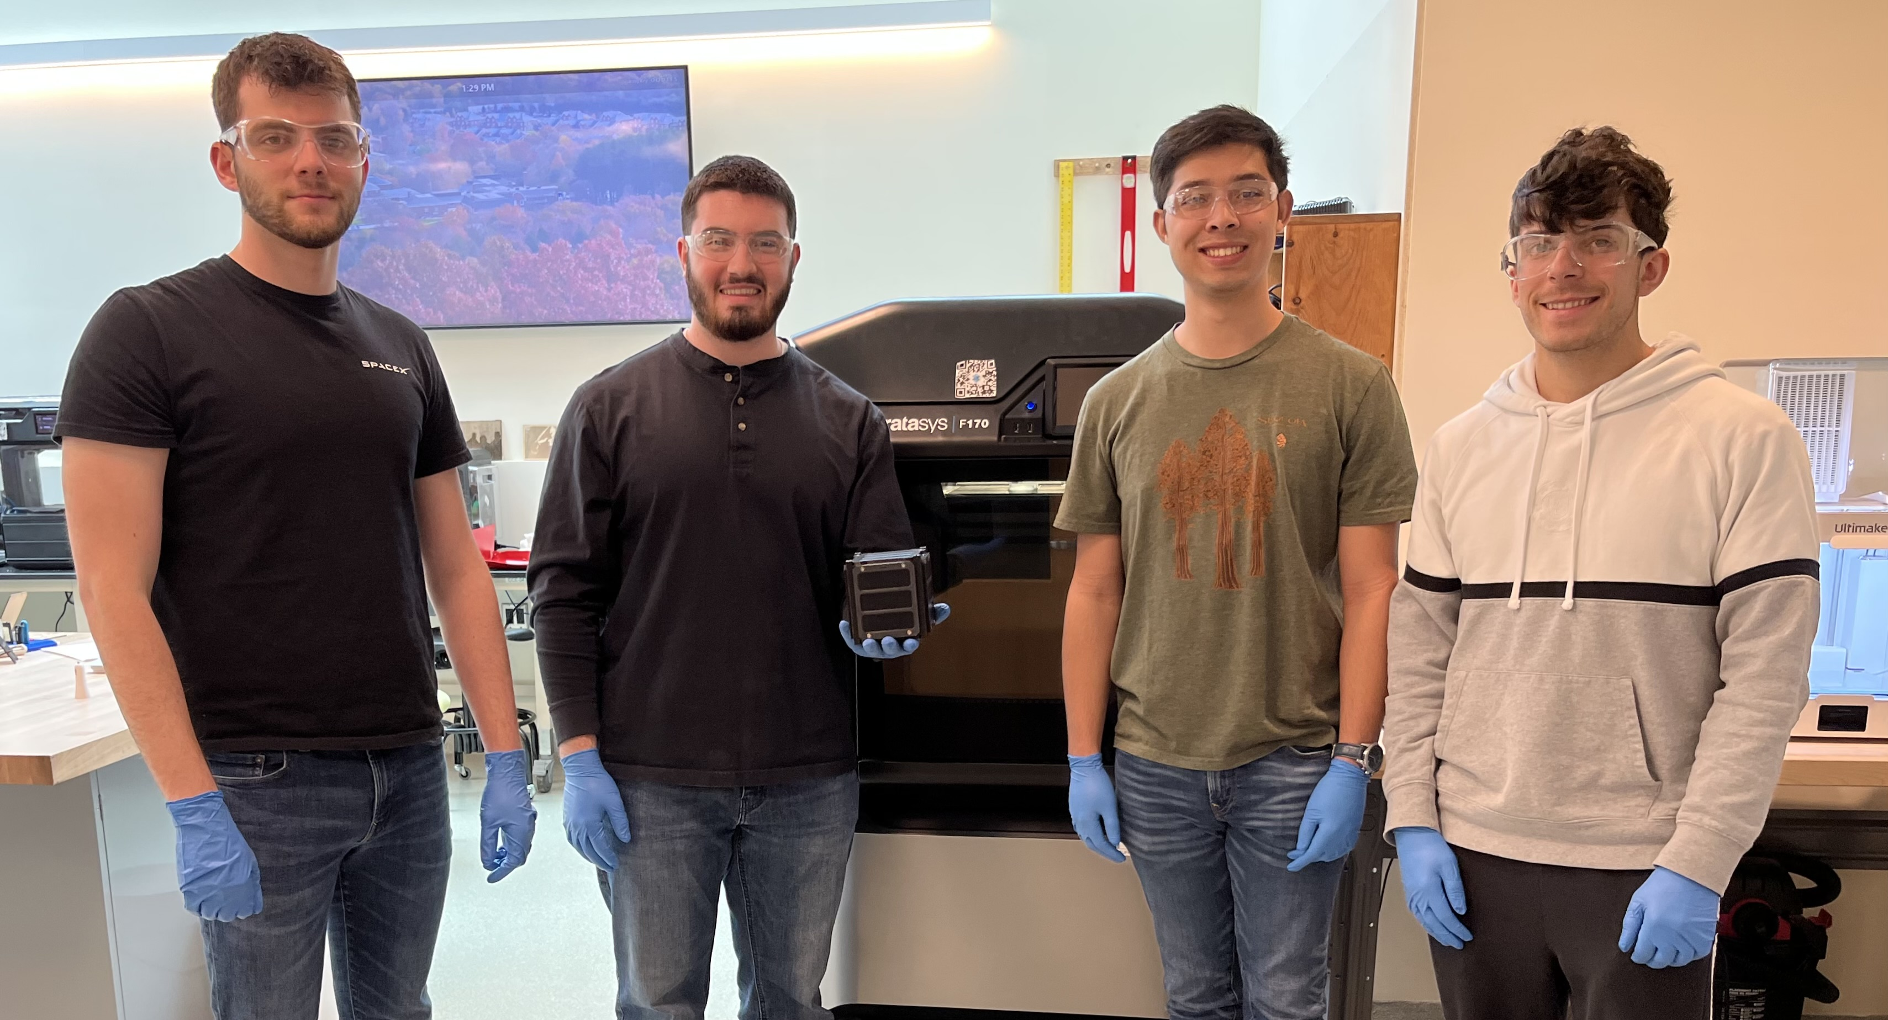
Conclusions
Conclusion
A proprietary frame, antenna deployment system, and solar panel assembly can be efficiently designed with complex geometries enabled by additive manufacturing at a lower weight and cost than OTS parts
Notes:
Over the course of the academic year, we were successfully able to create a frame, antenna deployment system, and solar panel assemblies which adhere to our problem statement. And on the slide you can see our team, from left to right, Me, Rocco, Gary, and Napoleon.

Slide 12
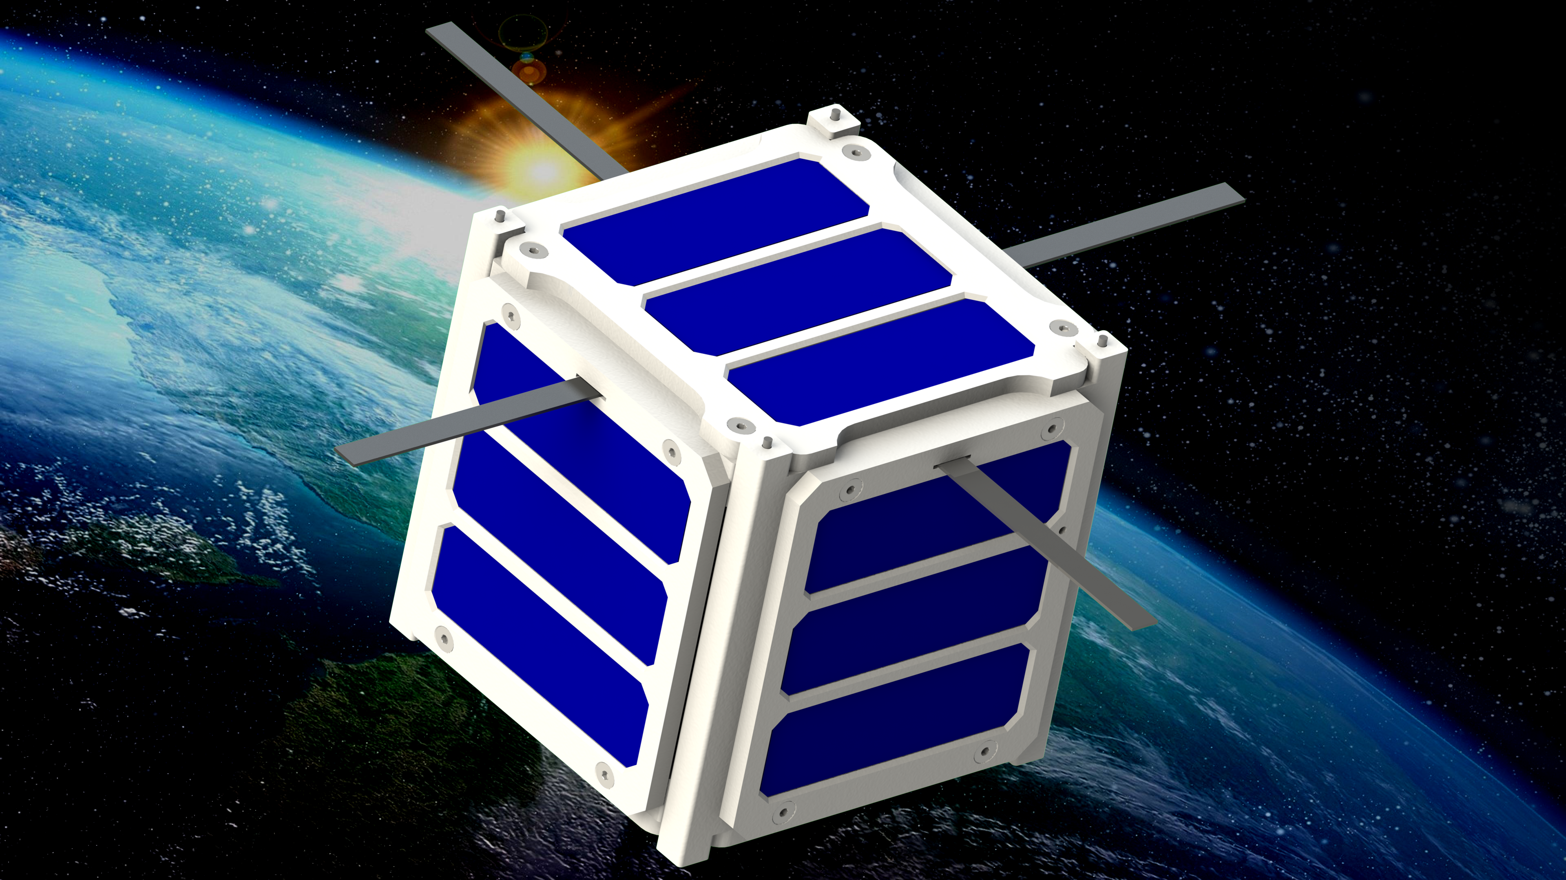
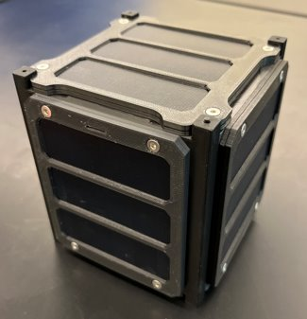
Future Work
Conclusion
Focused on hardware development
Prototype "QUbeSat 0"
Expand on the software (communications, data handling, etc.)
Notes:
In conclusion, our team has laid the foundation for future CubeSat project teams and created the main 3D printed assemblies. This project would be termed QUbeSat 0 as it is a proof of concept that our idea can work, but it needs to be finalized in what would be QUbeSat 1. Future teams can continue this project by working on the circuity and data systems, and we hope that Quinnipiac will eventually have a flight-ready CubeSat.

